Slide 1
Liberia Media Analysis
by Nathan Danielsen

Slide 2
Research and Hypothesis
Does the level of development and demography of a location in Liberia (county, municipality and lower levels like village) affected the quantity and quality of media coverage (local, national and international)?
I hypothesize that timely and accurate media coverage of significant events in Liberia is determined by population density but also by the availability (and functionality) of telecommunications infrastructure andlocalized political centers of gravity and governance. Furthermore I hypothesize that there is a significant politicization of media by political parties which is likely fueled by ethnic and linguistic divisions.
Plan to Test Since the quantity of Ebola media coverage has been extensive, I hope to test my hypothesis by contrasting Ebola media coverage content with geographical, demographic, other development indicators.

Slide 3

Sneak Preview
I ran out of time, but getting close… Data cleaning is a lot of work.

Slide 4

Design of Data Product
Python with SQL database
Each segment to be able to operate independently of each others.
Segments operate in an asynchronous environment – ie independent but collaborative workers
Data Segments - ingestion, cleaning, feature extraction, analysis and visualization.

Slide 5
Data Collection (Scraping)
Built a basic scraper to iterate through 9 Liberia online news content sites. These sites allowed a numeric post-fix to a url to easily allow iterate through content available.
Example:
http://www.liberianobserver.com/node/101
http://www.liberianobserver.com/node/102
Html data for all papers requested was saved to a txt document if the request response was a 200. The name for the file was the timestamp at time of request.
Request Period:
2015-05-03 12:33:16 to 2015-05-05 22:42:09 or ~2.5 days
52,995 requests to the 9 websites were made over the course of about a week. All requests and selected information was logged to file to monitor the collection and for later analysis.
25,105 requests returned a 200 status code. 27,890 requests failed or produced a code other than 200.

Slide 6


Data Collection Results
Daily Observer | 4,524
Front Page Africa | 4,359
GNN Liberia | 1,749
GOL Ministry of Information | 2,884
Post 1847 | 6,023
The Analyst | 304
The New Dawn | 5,262
*The GNN Liberia and the New Dawn in all cased returned 200 even in no article was available. For future note, I could develop a spam/ ham type model for identifying which pages to save.

Slide 7
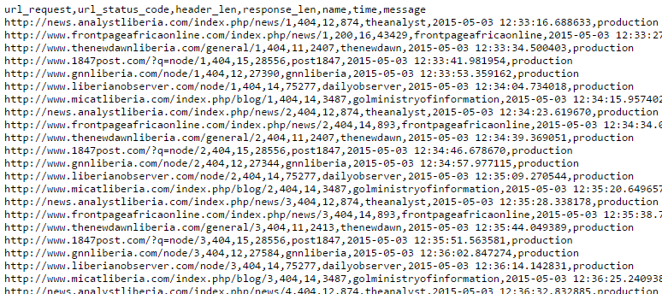
Log File
Data Dictionary
url_request - the website requested ie http://www.liberianobserver.com/node/101
url_status_code – The response from received website ie 200, 404,
header_len – Length of the header response
response_len – Length of the html code received (if received)
name – User defined name of publication / content site
time – Datetime stamp
message – User defined message ie 'Testing', 'Production', etc
*All header responses received from the sites where saved to a JSON file specific to each content site for future analysis.

Slide 8
Data Model for Analysis
With mind to scale up to larger data, a data model and supporting database was designed during the cleaning and design process. Unicode was selected as the encoding with the eye for future multi-language requirements.
Sqlalchemy with SQLite was selected because of it's pythonic nature, ease of use on the local machine, and Sqlalchemy's ability to easily drop in another database such as postgres.
Data Model Dictionary
publication_name – User Defined Name of Content Provider
true_url - True published URL of content
category – Content Provider Defined Category of Content
title – Title of Content Piece
datetime – Date Content Published
author – Content Piece By line (None value where not identified
clean_content – Main text content extracted from html
image_url – Lead image (None where no image published)

Slide 9
Data Extraction
Due to time constraints, only the Daily Observer's content extracted.
Beautifulsoup4 used for cleaning.
Arrow for converting publish date to python datetime objects.
Cleaned data was saved to a pickle file format to preserve data-types.
Unique Results
True_urls - 4,524
category - 192
title - 4,489
datetime - 4,453
author - 439
clean_content - 4,293
image_url - 3,383
*Many pieces of content lack author's attributed, images or content/ images. There are several editorials or cartoons that do not supply a 'By' attribute.

Slide 10
Feature Extraction
Using Pandas and NLTK, several features were extracted for analysis.
Data Dictionary
Lead – First four sentences that normally represent a concise summary of story.
ebola_title – 1 if 'ebola' or 'ebv' in title, 0 if not
ebola_lead -- 1 if 'ebola' or 'ebv' in lead, 0 if not
ebola_content -- 1 if 'ebola' or 'ebv' in lead, 0 if not
location_title – List of counties or county capitals referenced.
location_lead – List of counties or county capitals referenced.
location_content – List of counties or county capitals referenced.
I still need to pull out the dummy variables to tag each row with 1 or 0 if it contains the geographic location.
Tip to share: check out NLTK ngrams for selecting groups of words.

Slide 11
Feature Extraction (cont)
Initial Results
Ebola in title: 458
Ebola in lead: 908
Ebola in main content: 1,229
Location Data: Need to make dummy variables.
Initial Findings
Ebola is definitely in a topic in news articles.
From my initial, terrible visualizations the coverage peak corresponded with the virus outbreak.

Slide 12
Modeling
Next Steps:
> Compare infection rates by county with ebola news coverage by county.
> Compare ratio of ebola stories per county population to infections per county population.
> Add other variables such as GDP per capita, literacy rates, etc
> Is there a linear model?
> …
> Profit!?
Particular Challenges - Visualization
I found it incredibly hard to find resources to do pandas time series visualizations.
I wished to contrast weekly number of 'ebola' stories per calendar week with 'ebola' stories per region in a time-series plot and contrast that with infections per week per region.

Slide 13
Lessons Learned
As I evaluated each media content site for scraping, I could have easily built the scraper.
Building a model for database engine took too much time. Considering the small size of the data, Pandas was a much better fit for data processing and analysis. But I'm glad that I thought deeply about the data types to extract.
Writing unit tests for each section of the project would have made debugging much easier, but as this was a learning project, I didn't know which tests to write or how to test capability.
As is often said, data science is mostly about data cleaning. In this project, it took me approximately 90% of the time to collect and clean the data. I'm still rushing to analyze it.
I need to work through the NLTK book and get a better understanding of some of it's amazing tools that would save me time.
Life gets in the way of being a weekend data science warrior. Also moving to a new apartment ate up a lot of my time.

Slide 14
Applications and Next Steps
Potential to Scale Up to 'Bigger' Data Models
Raw web pages could be stored to a cloud database -- easier to access and categorize them.
Refactor and collect data for another target country, my code is fairly generalized.
Write a better scraper that re-requests 3 times to a site if a non-200 is received.
Real-time scheduled data collection and processing using a web service like AWS.
Business Applications
This data product would be adapted to assess the impact of my organizations interventions on media content producers and even journalists/authors. Furthermore, it would be tailored to identify trends in civil society and potentially used to identify propaganda campaigns.

